Slide 1




VIRTUAL VISTA 2.0
- Embrace your Ideas
TEAM VIPER
SHEIKH WASIMUDDIN
ARNAV UPATE
YESHWANTRAO CHAVAN COLLEGE OF ENGINEERING
MAHARASHTRA NAGPUR

Slide 2
0
Problem Statement
Problem Statement: Affordable Real-Time Heart Rate Monitoring with Data Integration
Problem Description: In today's world, real-time health tracking is crucial, especially in remote or low-income areas. Commercial heart rate monitors are often expensive and inaccessible. We developed a low-cost, reliable heart rate monitoring system with seamless data logging to spreadsheets. It enables easy remote tracking, supporting better preventive care and timely medical response.
Approach:
Component Selection:
Chose cost-effective yet reliable components like a pulse sensor
( SEN0203) and microcontroller (ESP32) to minimize hardware costs without compromising accuracy.
System Design & Development:
Built a simple circuit for capturing heart rate data and programmed the microcontroller to process and transmit the readings.
Data Integration: Implemented real-time data transmission to Google Sheets or Excel using tools like Google Apps Script or ESP32 Wi-Fi module with APIs, enabling automated logging and remote monitoring.
Testing & Validation Compared readings from our prototype with standard commercial devices to ensure reliability and accuracy.
User Interface & Usability:Focused on creating a minimal, easy-to-use interface for users and health workers, making the system suitable for both tech-savvy and non-technical individuals.
Notes:
Idea Submissions Form – Details of the form Topic
Thesis Abstract Concept Note What is the solution Build? Business use case (Less than 100 – 200 words) Judge and filter becomes easy

Slide 3

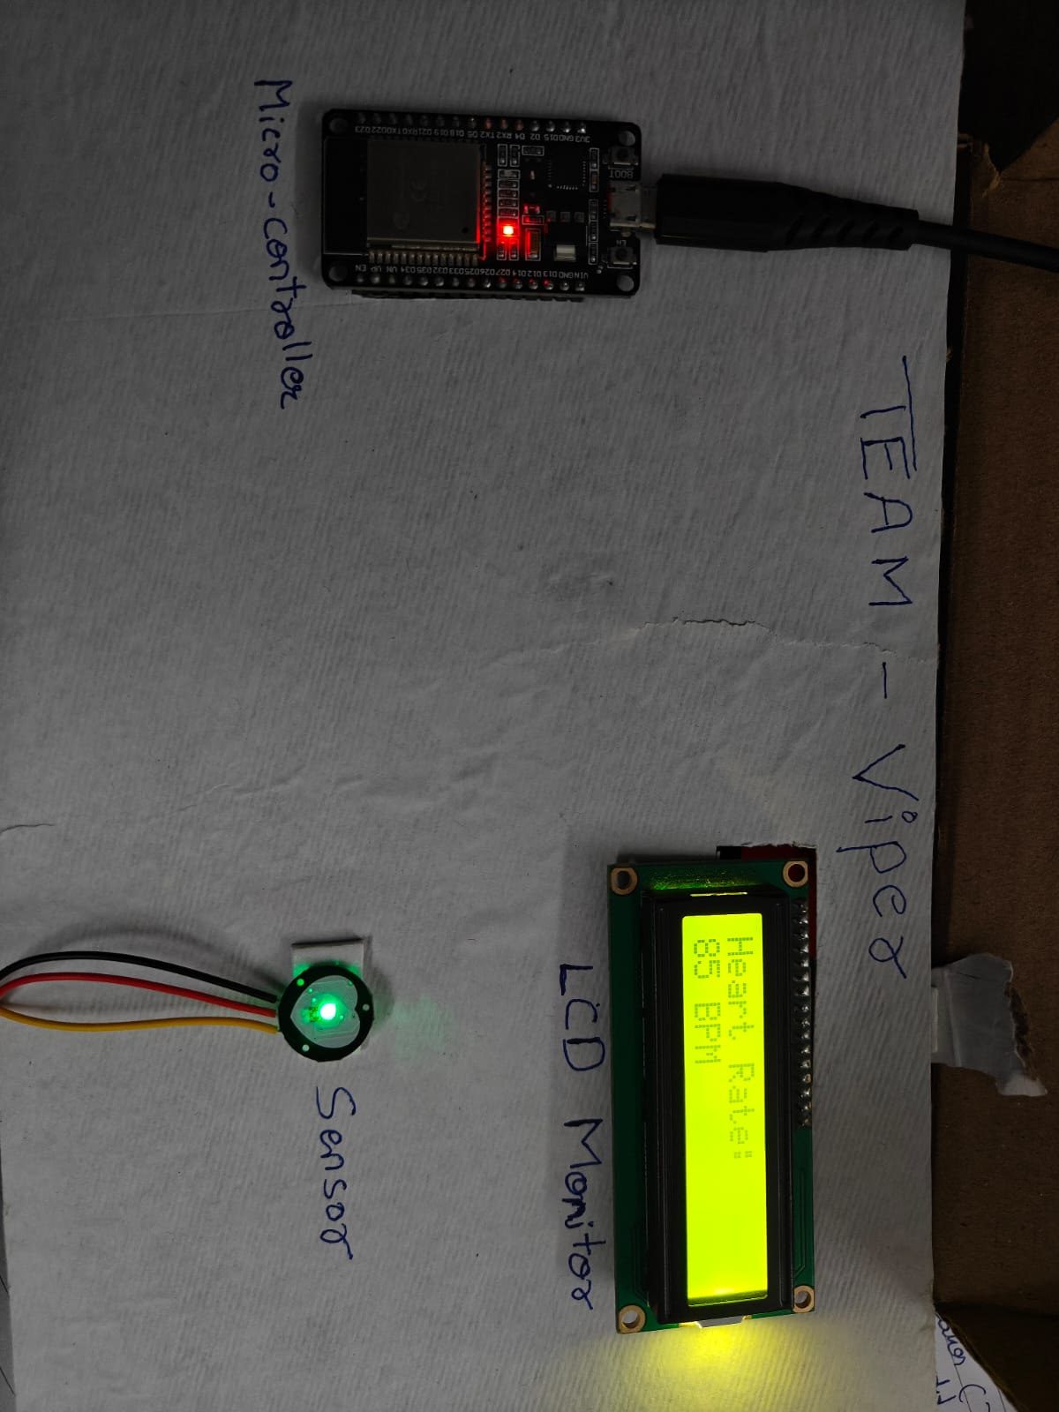
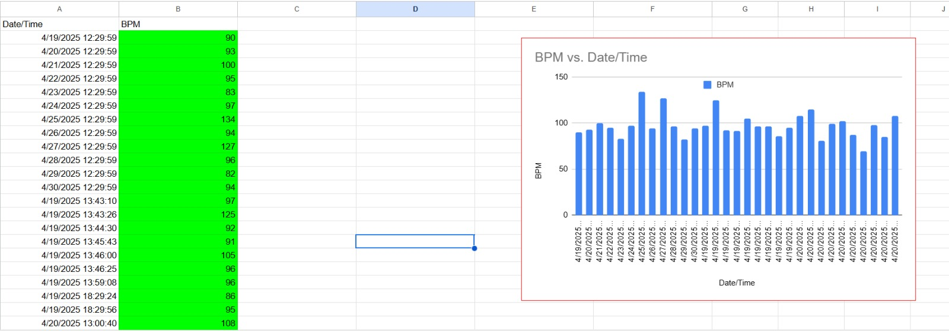
Solution
Our platform delivers a low-cost, reliable heart rate monitoring system with real-time data logging and accessibility for all. Designed with simplicity and scalability in mind, the system empowers users and health workers in remote areas to monitor vitals effectively.
Innovative Solutions:
1️⃣ Low-Cost Sensor Integration (💡) – Utilizes affordable hardware (e.g., SEN0203+ ESP32) to deliver accurate heart rate tracking at a fraction of the market cost.
2️⃣ Spreadsheet Auto-Logging (📊) – Real-time integration with Google Sheets or Excel for seamless data storage, analysis, and sharing.
3️⃣ WiFi-Enabled Remote Monitoring (🌐) – ESP32-powered data transmission enables caregivers or doctors to monitor patients remotely.
4️⃣ Minimalist Health Dashboard (📱) – Simple UI/UX design for mobile and desktop, ideal for elderly or low-literacy users.
5️⃣ Battery-Efficient Portable Design (🔋) – Compact and energy-efficient build for use in rural health camps and remote homes.
Notes:
Idea Submissions Form – Details of the form Topic
Thesis Abstract Concept Note What is the solution Build? Business use case (Less than 100 – 200 words) Judge and filter becomes easy

Slide 4
AI chatbot processes via Azure OpenAi
Use of Power BI & App Script API
Power BI + App Script API Interaction
1️⃣ Power BI Integration 🚀 🔹 Dynamic Health Dashboards – Visualizes real-time heart rate data from Google Sheets in interactive charts and graphs. 🔹 Trend Analysis & Insights – Identifies abnormal patterns, averages, and user-specific trends for early detection. 🔹 Custom Alerts & Reports – Sends health summaries or anomaly alerts to doctors or caregivers via email or mobile.
2️⃣ Google Spreadsheet + App Script API 🌍 🔹 Automated Data Sync – Live heart rate data is pushed to Sheets via App Script, keeping Power BI dashboards up-to-date. 🔹 Scheduled Updates & Triggers – App Script enables automated refreshes and threshold-based triggers for reporting. 🔹 Secure & Shareable Logs – Health logs are centralized, easy to share, and secure for medical review. 🌟 Combined Impact 💡
✅ Real-time heart data insights for decision making ✅ Smart visual dashboards for caregivers & health teams ✅ End-to-end analytics with zero-code automation for rural & remote health monitoring
Reading is stored in Spreadsheet and PowerBI dashboard
Measure heart rate using sensor
User
Visualization
Of data in PowerBI
User gates reading
Notes:
Idea Submissions Form – Details of the form Topic
Thesis Abstract Concept Note What is the solution Build? Business use case (Less than 100 – 200 words) Judge and filter becomes easy

Slide 5
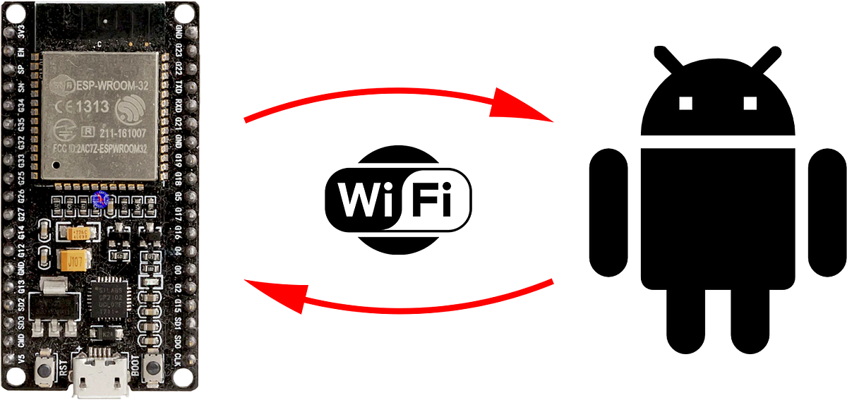
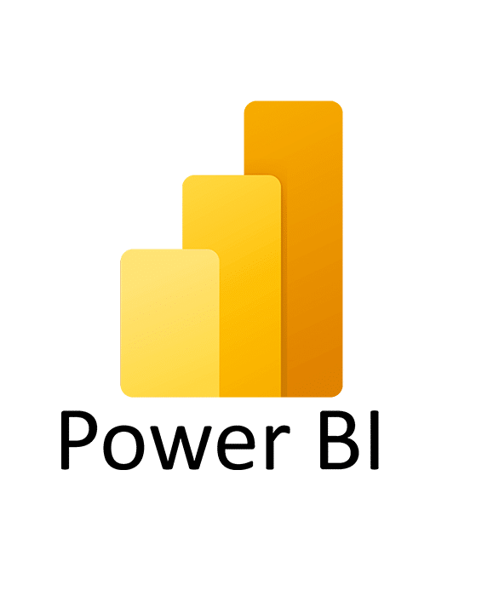

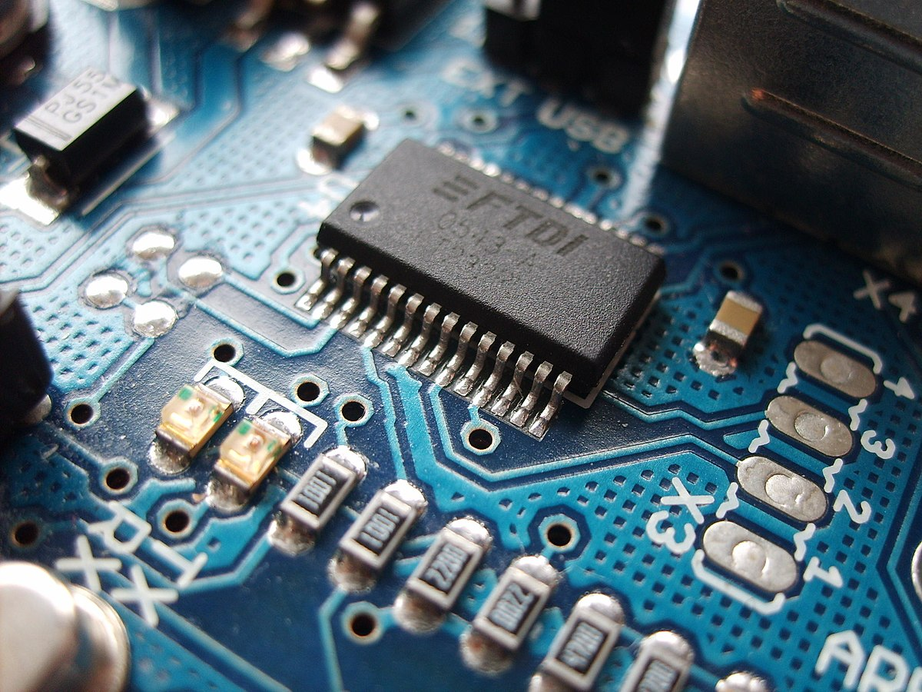
Tech stack/Technology Used
Layer Hardware Components(Pluse Sensor,ESP32,Breadboard,LCD,Jumper Wire)
Software & Programming( Arduino IDE ,Google Apps Script)
Visualization & Analytics(Power BI)
Cloud & Integration Tools( Google Apps Script API)
Notes:
Idea Submissions Form – Details of the form Topic
Thesis Abstract Concept Note What is the solution Build? Business use case (Less than 100 – 200 words) Judge and filter becomes easy

Slide 6

Unique Selling Proposition
✅ Affordable Yet Scalable – Currently built under ₹500, with future integrations (Power BI, cloud syncing, advanced sensors) scaling it to just ₹2000—still far cheaper than commercial alternatives. ✅ Cloud-Connected Health Logs – Real-time vitals synced to Google Sheets via App Script, enabling easy tracking and sharing. ✅ Portable & Offline-Friendly – Compact, battery-powered, and designed to work even in low-connectivity areas with offline data sync. ✅ Smart Visual Analytics – Future-ready with Power BI integration for predictive insights, anomaly alerts, and health trend monitoring. ✅ Open, Customizable, and Sustainable – Built using open-source tools, allowing for easy adaptation and local manufacturing..
Notes:
Idea Submissions Form – Details of the form Topic
Thesis Abstract Concept Note What is the solution Build? Business use case (Less than 100 – 200 words) Judge and filter becomes easy

Slide 7
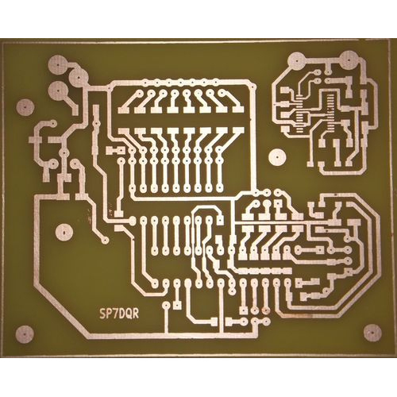


Future Integration
Gender-Based Health Analysis Add Male/Female selection to tailor heart rate and health data interpretation based on gender-specific thresholds and trends.
Age Group Insights via Keypad Input Integrate a numeric keypad for users to input their age, enabling age-based analytics and personalized health alerts.
SpO₂ Monitoring Support Incorporate a blood oxygen (SpO₂) sensor for enhanced vital monitoring, useful for early detection of respiratory issues.
Custom PCB Development Design and manufacture a fully functional PCB for a compact, robust, and production-ready version of the device.
Personalized Health Dashboards Display age and gender-based data visualizations and trends to help users and caregivers make informed health decisions.
Predictive Health Notifications Use historical data to predict anomalies and send early warning notifications via app, SMS, or email.
Notes:
Idea Submissions Form – Details of the form Topic
Thesis Abstract Concept Note What is the solution Build? Business use case (Less than 100 – 200 words) Judge and filter becomes easy

Slide 8


